Slide 1
Sampling Algorithm
Pravin Y Pawar

Slide 2
Sampling
Select a subset of data to be analyzed such that it has approximately the same properties of the original data
Do we have the length of the stream?
Random Sampling
Each element has equal probability of being selected
Reservoir sampling
A technique to maintain online random sample

Slide 3
Reservoir Sampling
Used to maintain an online random sample
Maintains a sample of size k, known as reservoir
Every new element has a probability k/n of replacing an old element in the reservoir
Let us say, k=1: An item in a stream of length n replaces the element in the reservoir with probability 1/n

Slide 4
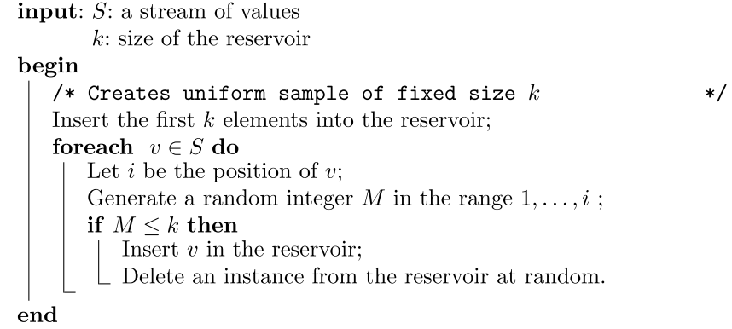
Reservoir Sampling Algorithm

Slide 5
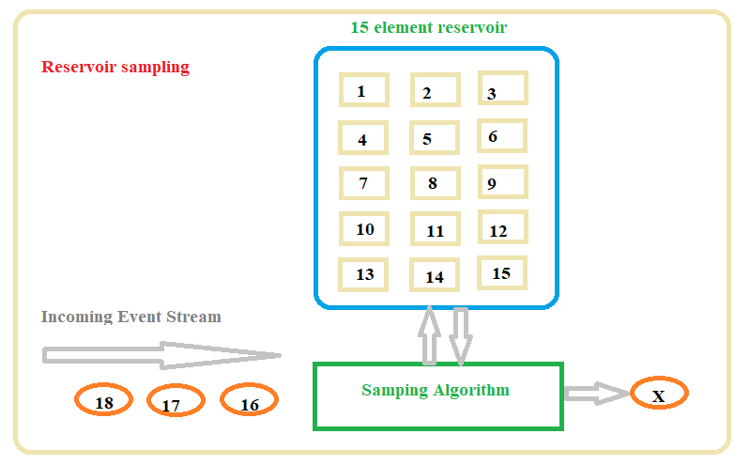
Reservoir Sampling Example

Slide 6
Hot List Problem
Hot List for a Retail Business
Retail data warehouse of big ecommerce platform
The actual size of the data warehouse is 3 TB of data
Hundreds of gigabytes of new sales records are updated daily
Order of magnitude of the diﬀerent items is millions
Restricted memory
The goal is to
continuously maintain a list of the top-k most frequent elements in a stream
rank the items and absolute count is immaterial

Slide 7
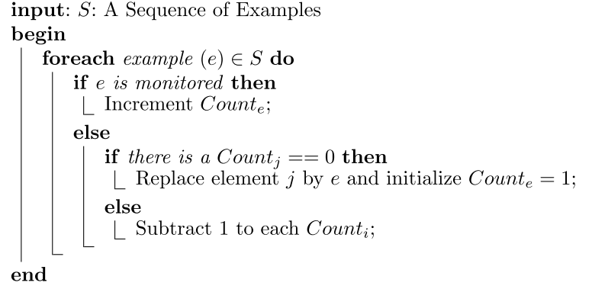
Hot List Problem – Frequent Algorithm

Slide 8
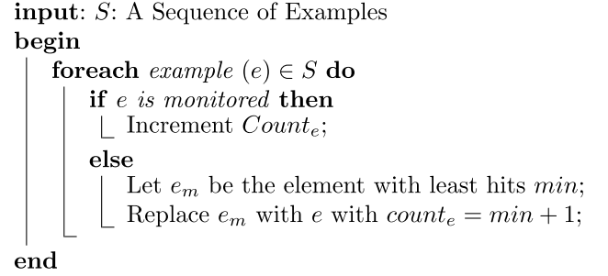
Hot List Problem – Space Saving Algorithm

Slide 9
Thank You!
In our next session: Decaying Window

